Slide 1

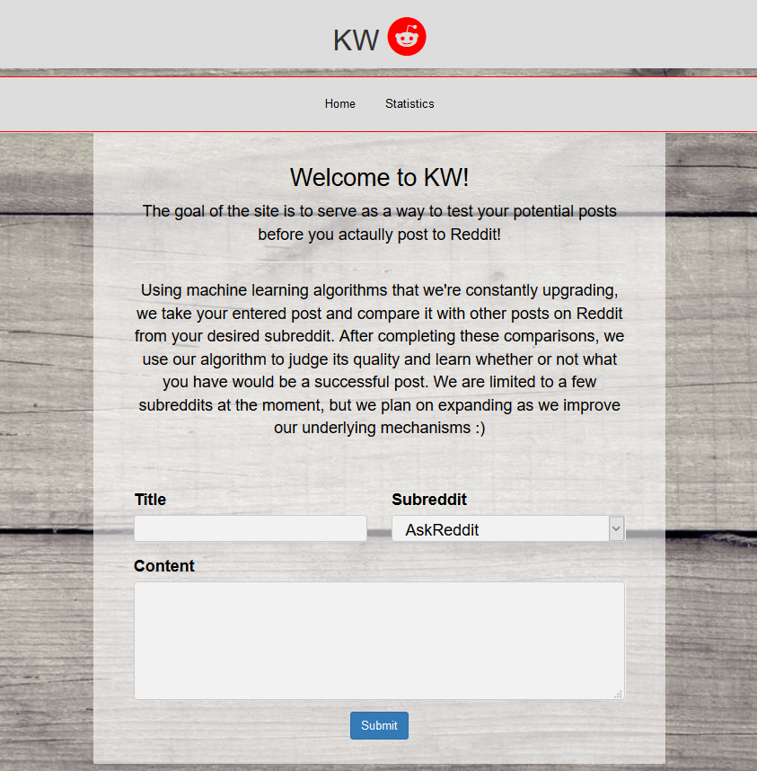
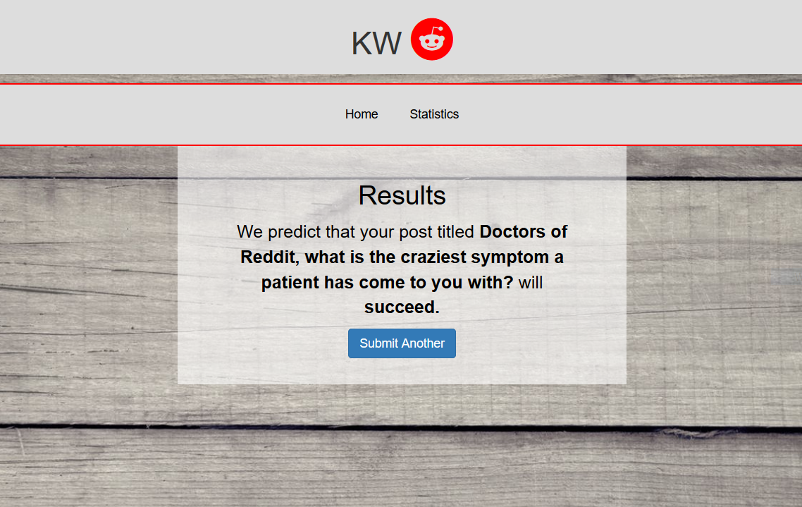
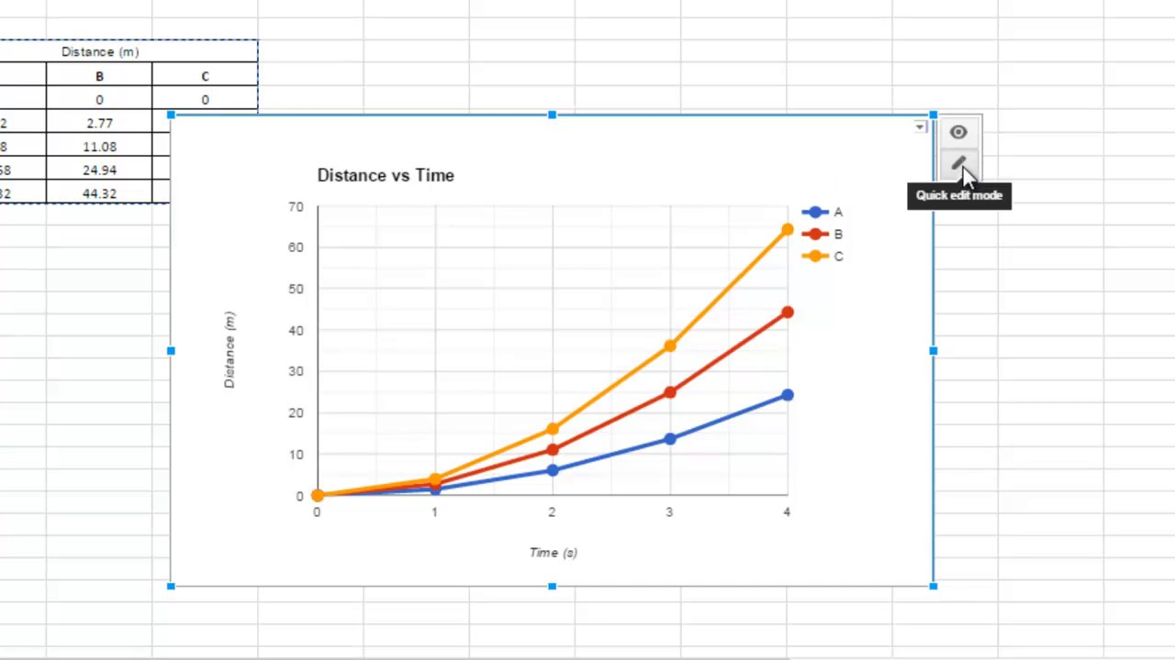
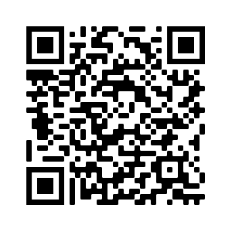
KW
Approaching Text Based Subreddits Through Machine Learning
Hagan Brewer, Joshua Brucker, Solomon Kim, Nelson Vargas
Abstract: A large part of reddit's success as a "social news aggregation, web content rating, and discussion website" should be accredited to the implementation of karma as a powerful reward system that the users can use to control what content can be viewed. Posts and inevitably users that gain large amounts of upvotes (a large karma score) are viewed with greater frequency and in higher regard respectively. Our team endeavors to build a heuristic system to grade the degree to which a new reddit post will be popular within its respective subreddit. The team intends to quantify what makes a reddit post successful and strictly adheres to ethical research practices with respect to social engineering.
Figure 1: Home Page
Approach: We used a variety of algorithms such as
Figure 2: Results Page
Technologies:
Python
Bootstrap/HTML/CSS
Flask
Natural Language Processing
Features:
Title Analysis
Access to complete Reddit archive
Uses Real Time Data
Conclusion: We found that
Figure 3: Graph Representing Results
Future Work: We would like to expand our machine learning algorithms to include Images to include visual subreddits like r/Pics
Visit our Repo at https://github.com/csc4790-fall2019/sp-hagan-solomon-josh-nelson/wiki or Scan the QR Code
We would like to acknowledge the follow people for their help: Dr. Benjamin Mitchell, Jason Dobies, Villanova Computer Science Department

